Slide 1
Working and Long-Term Memory
HUDK 4029: Human Cognition and Learning

Slide 2
Announcements
Writing 1 will be open one week from the due date (follow guidelines!)
Background reading for the course
Project soft deadline for topic (Oct 17 - choose topic)
Research participation
Last name on name tags

Slide 3
The Computer Analogy of Cognition

Slide 4
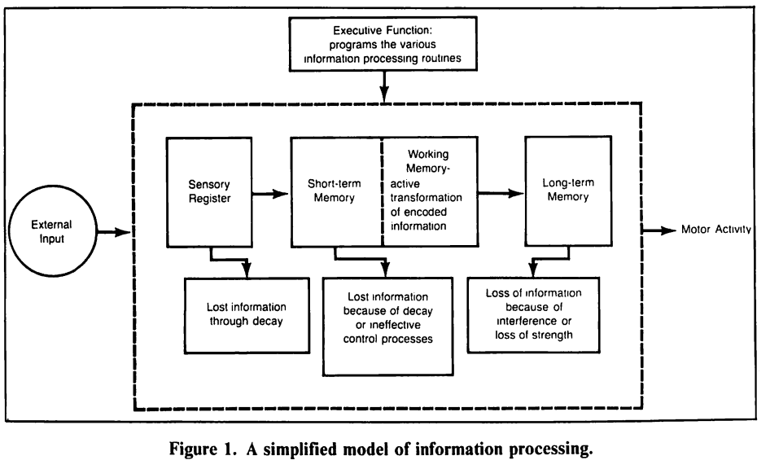
Components of the information processing system
Swanson, H. L. (1987). Information processing theory and learning disabilities: An overview. Journal of learning Disabilities, 20(1), 3-7.

Slide 5
What is
Working Memory?
A system for holding the information needed to perform a task and is associated with many aspects of learning
Proposed by Baddeley (1986)
Composed of a central executive which directs the usage of two subsystems:
Visuospatial Sketchpad
Phonological Loop

Slide 6
Phonological Loop
Composed of the Articulatory Process and the phonological store
Articulatory Process is like an “inner voice” which rehearses verbal information
Rehearsal of verbal information during imaging studies shows activation in Broca’s area even participants are not speaking aloud
Phonological Store is like an “inner ear” which hears the inner voice and stores that information as
The word length effect is one of the pieces of evidence of the existence of the phonological loop
Smith, E. E., & Jonides, J. (1995). Working memory in humans: Neuropsychological evidence. The MIT Press.

Slide 7
Visuospatial Sketchpad
Like a mental whiteboard
Can (briefly) hold visual or spatial information over a brief period of time
There is less research on this aspect of WM but one area that has been looked at repeatedly is mathematics learning, particularly for children. A more developed VSSP is associated with higher performance and achievement from an early age
Seems to be most important during earlier learning of a skill rather than at later points during the mastery process.
Allen, K., Higgins, S., & Adams, J. (2019). The relationship between visuospatial working memory and mathematical performance in school-aged children: a systematic review. Educational Psychology Review, 31, 509-531.

Slide 8
How does information enter the LT storage?
Earlier models of memory proposed that rehearsal of the material of the method for moving it to LT
There is *some* evidence that rehearsal enhances memory, but there’s also evidence to the contrary
The key seems to be depth of processing (Craik & Lockhart, 1972) Information that takes on meaning has a better chance of being remembered.

Slide 9
Meaning vs meaningless (for some!)
Bag
Sand
Tooth
Rug
Pen
Luz
Rey
Pez
Miel
Red

Slide 10
(read this)
Characteristic features of parrots include a strong, curved bill, an upright stance, strong legs, and clawed zygodactyl feet. Many parrots are vividly coloured, and some are multi-coloured. Most parrots exhibit little or no sexual dimorphism in the visual spectrum. They form the most variably sized bird order in terms of length.
The most important components of most parrots' diets are seeds, nuts, fruit, buds, and other plant material. A few species sometimes eat animals and carrion, while the lories and lorikeets are specialised for feeding on floral nectar and soft fruits. Almost all parrots nest in tree hollows (or nest boxes in captivity), and lay white eggs from which hatch altricial (helpless) young.

Slide 11
Cognitive Load Theory
Fundamentally it is an instructional theory based on our understanding of human cognitive architecture (the relations between working memory and long-term memory)
It says that, because learning of secondary knowledge requires instruction, we need to carefully consider how we present the material that is to-be-learned so that it can be properly managed by the available cognitive resources
What is it?

Slide 12
Types of Cognitive Load
Intrinsic: refers to the nature of the information, specifically the complexity and element interactivity
Fixed, so can only be altered by changing what is learned or the levels of expertise of the particular learner
Extrinsic: refers to how the information is learned (instruction)
Sweller, J. (2011). Cognitive load theory. In Psychology of learning and motivation (Vol. 55, pp. 37-76). Academic Press.

Slide 13
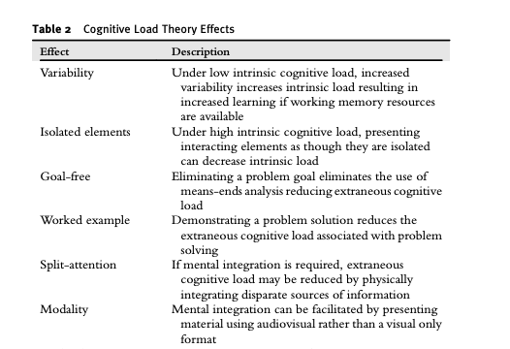
Types of Cognitive Load

Slide 14
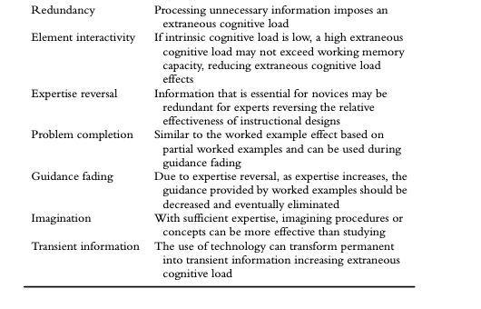
Types of Cognitive Load

Slide 15
Cognitive Overload
What is Cognitive Overload?
Sweller leans heavily into two learning mechanisms. What are they and do they aid working memory?

Slide 16
In terms of learning and cognitive functioning, what is the importance of long-term memory?

Slide 17
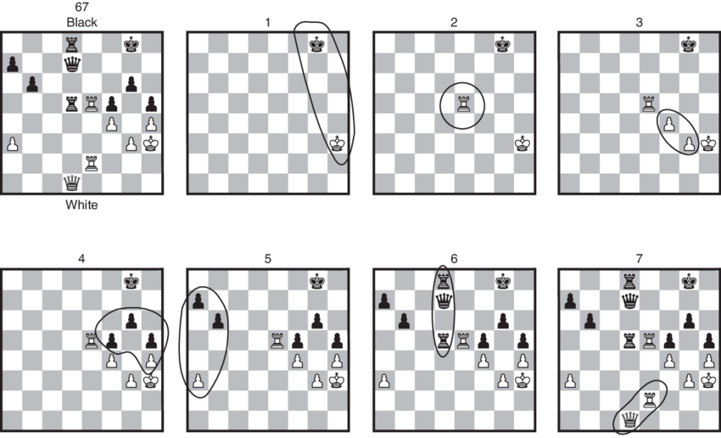
Schema Acquisition: Chess study
Chase, W. G., & Simon, H. A. (1973). The mind's eye in chess. In Visual information processing (pp. 215-281). Academic Press.

Slide 18
Automation
As tasks become practiced, they become more automatic and require less and less central cognition to execute
Automaticity is a matter of degree
An important function of automaticity is that it reduces pressure on the working memory
Additionally, automaticity enables parallel processing
Anderson, 2022

Slide 19
Can we train working memory?

Slide 20
Not Exactly…
Training for working memory (and other components of the traditional conception of executive function) tend to be specific to the paradigm used
So the question remains - how can we improve cognitive overload?
Holmes, J., Woolgar, F., Hampshire, A., & Gathercole, S. E. (2019). Are working memory training effects paradigm-specific?. Frontiers in psychology, 10, 1103.

Slide 21
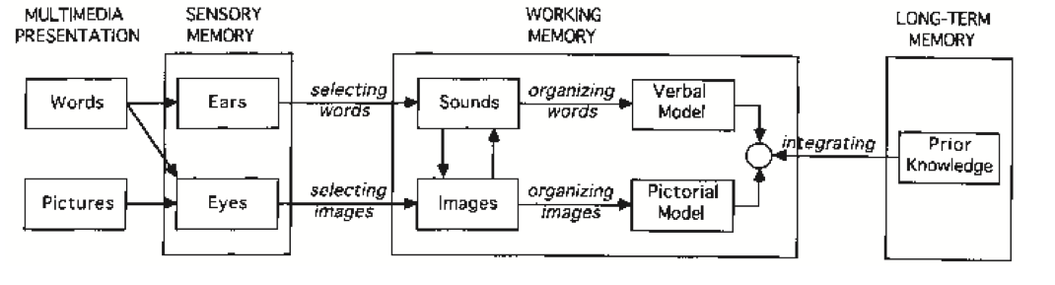
Multimedia Learning and
Cognitive Overload
(Mayer & Moreno, 2003)
A potential problem is that the processing demands evoked by the learning task may exceed the processing capacity of the cognitive system (Mayer & Moreno, 2003, p.45)

Slide 22
Essential Processing
3 kinds of cognitive-processing demands
Incidental Processing
Representational Holding

Slide 23
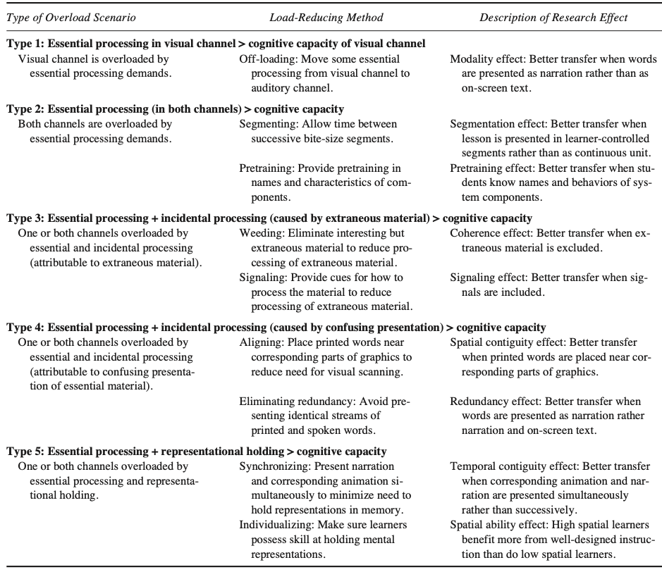

Slide 24
Discussion
Do you think there are any school subjects which could make more use of the visual and auditory channels in order to present information? Why do you think they currently do not?
Mayer & Moreno (2003) remark the importance of further research on how to measure cognitive load, particularly:
Measuring the cognitive load experienced by learners
Measuring the cognitive load imposed by instructional materials
Measuring the cognitive capacities of learners
What are some of the possible impacts of being able to measure these in accurate ways? Do you think it is possible?

Slide 25
What are some other causes of cognitive overload?

Slide 26
Working Memory and Learning

Slide 27
Studying
Effective studying requires knowledge of what information is already learned relative to what needs to be learned.
Information needs to be practiced well enough to enter LT
What is required for effective studying?

Slide 28
The Spacing Effect
When studying, the most successful presentations require spacing (time) between the presentation of the material and the practice episodes
If we know that practice and meaning are related to enhanced long-term storage, why does cramming not work?

Slide 29
Working Memory Resource Depletion Hypothesis
(why cramming doesn’t work)
“working memory resources become depleted after a period of sustained cognitive exertion resulting in a reduced capacity to commit further resources.”
Essentially, massing practice of materials depletes working memory resources
This happens due to effort, and so a rest is needed before subsequent practice
This can also happen in collaborative learning settings (high WM apacity learners tend to experience less depletion and thus more learning compared to individual study)
Sweller, J., van Merriënboer, J. J., & Paas, F. (2019). Cognitive architecture and instructional design: 20 years later. Educational psychology review, 31, 261-292.
Du, X., Chen, C., & Lin, H. (2022). The impact of working memory capacity on collaborative learning in elementary school students. Frontiers in Psychology, 13, 7686.

